Slide 1
Mining Frequent Patterns: Association Rules
IST565 Data Mining
Week 3
Notes:
This week we will learn about association rule mining.

Slide 2
What Is Frequent Pattern Analysis?
Frequent pattern
What products do people frequently buy together?
What other products would people buy if they bought a laptop?

Slide 3
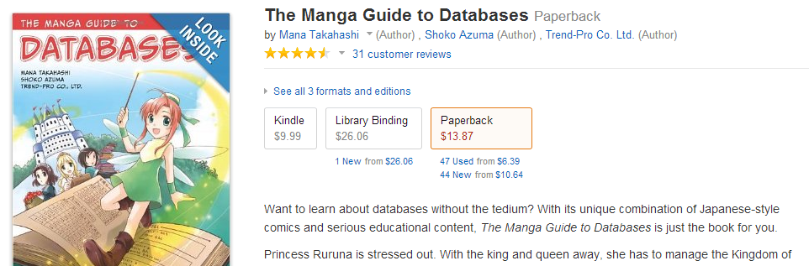
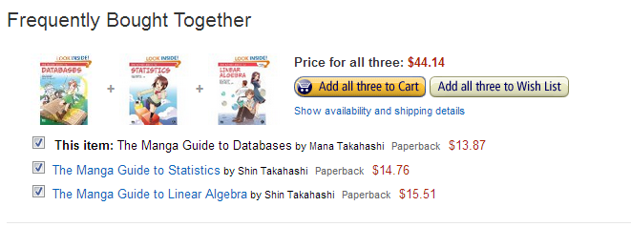
Notes:
Association Rule Mining is commonly used by

Slide 4
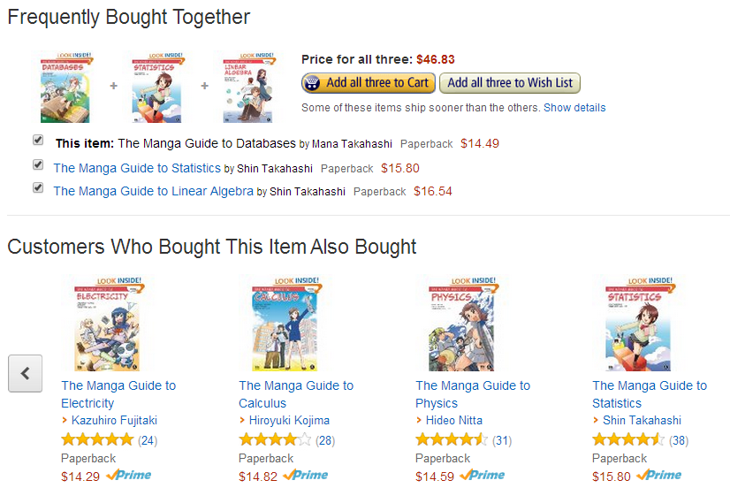

Slide 5
Association Rule Mining
Given a set of transactions, find rules that will predict the occurrence of an item based on the occurrences of other items in the transaction
Market-Basket transactions
Example of Association Rules
{Diaper} → {Beer}, {Milk, Bread} → {Eggs,Coke}, {Beer, Bread} → {Milk},
Implication means co-occurrence, not causality!

Slide 6
Association Rule (AR) Mining
Textbook chapter 6 requires some background knowledge in undergraduate computer science courses like data structure.
Requirement for this class: learn the basic concepts about AR and the main idea of the Apriori algorithm.

Slide 7
More applications
Product recommendation
E.g. Amazon.com
Catalog design
Web log (click stream) analysis
DNA sequence analysis

Slide 8
Exercise: AR applications
Find a business that has not yet used association rule mining for business intelligence. Explain whether or not associate rule mining can be helpful for this business.
For example, I have not seen any restaurants use association rule mining, but as a customer I would like to know which dishes are popular, which dishes are frequently ordered together, and what else did customers order if they had ordered dish X?

Slide 9
Basic concepts in AR mining

Slide 10
Frequent itemset
Transaction-id | Items bought *
10 | A, B, D
20 | A, C, D
30 | A, D, E
40 | B, E, F
50 | B, C, D, E, F
Can you answer the following questions?
- Which two items are frequently bought together?
- Which three items are often bought together?
- …
Notes:
Let’s look this sample transaction data. It includes 5 transactions, each with a unique id, and a number of product items bought. Can you answer questions by just eyeballing the data? Probably not that hard when the data set is small.
But when the data set is large, we need to write a computer program to help us count.

Slide 11
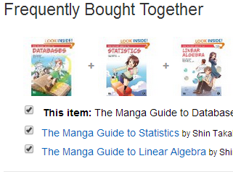
Definition: Frequent Itemset
Itemset
a collection of one or more items
k-itemset contains k items
1-itemset:
{A}:3, {B}:3, {C}:2, {D}:4, {E}:3, {F}:2
2-itemset:
{A,B}:1; {A,D}:3
3-itemset:
{A,B,C}:0, {B, E, F}:2
Transaction-id | Items bought
10 | A, B, D
20 | A, C, D
30 | A, D, E
40 | B, E, F
50 | B, C, D, E, F
Notes:
In this case, we define … and count 1-itemsets as…, 2-itemsets, no 3-itemsets

Slide 12
Metrics to evaluate frequent level of itemsets
How frequent is an itemset?
Support count
Number of transactions that contain an itemset
support_count({ D, E } ) = 2
Support percentage
Fraction of transactions that contain an itemset
support( {D, E}) = 2/5
Frequent Itemset
an itemset with support >= threshold
Notes:
In the previous example we have counted that a 2-itemset {D, E}

Slide 13
Definition: Association Rule
Association Rule
an implication of the form X → Y,
where X and Y are itemsets,
e.g. { E, F } → { B }
Example Rules:
{B, E} → {F}
{E, F} → {B}
{B, F} → {E}
{B} → {E, F}
{E} → {B, F}
{F} → {B, E}
Transaction-id | Items bought
10 | A, B, D
20 | A, C, D
30 | A, D, E
40 | B, E, F
50 | B, C, D, E, F
RHS:
Right-Hand Side
LHS:
Left-Hand Side
Notes:
Association rules are generated based on frequent itemsets
We can split a frequent itemsets into two subsets, put one on the LHS, the other on the RHS

Slide 14
Metrics to evaluate the rule’s strength
Rule Evaluation Metrics
Support P(X, Y)
Fraction of transactions that contain both X and Y
Support({E, F} → {B}) = support_count({B,E,F}) / N = 2/5
Confidence P(Y|X)=P(X, Y)/P(X)
How frequently items in Y appear in transactions that contain X
confidence({E,F} → {B}) = support({B,E,F}} / support({E,F}) = support_count({B,E,F}) / support_count({E,F}) = 2/2 = 1
Notes:
With so many rules generated, we cannot show all of them to users. We need some measure to evaluate the strength of the rules and rank them, pick the strongest to show to users
Support for the rule is the same as the support for the frequent itemset, how many transactions contain them.
Confidence: conditional probability when people bought x, how likely would they also buy Y

Slide 15
Confidence
confidence({E,F} → {B}) = support({B,E,F}} / support({E,F}) = support_count({B,E,F}) /support_count({E,F}) = 2/2 = 1
Switching LHS and RHS results in different rules with different confidence
Notes:
When switching the LHS and RHS, the rules are different, their confidence is different, because the denominator is different

Slide 16
Exercise: AR metrics
Calculate the support and confidence of association rules {A}->{D} and {D}->{A}
Transaction-id | Items bought
10 | A, B, D
20 | A, C, D
30 | A, D, E
40 | B, E, F
50 | B, C, D, E, F
Notes:
Support P(A,D)/N=3/5=.60
Confidence
P(A,D)/P(A)=3/3=1
P(A,D)/P(D)=3/4=.75

Slide 17
Apriori algorithm

Slide 18
How to mine association rules?
Given a set of transactions T, the goal of association rule mining is to find all rules having
support ≥ minsup threshold
confidence ≥ minconf threshold
Brute-force approach:
List all possible association rules
Compute the support and confidence for each rule
Prune rules that fail the minsup and minconf thresholds
⇒ Computationally prohibitive!

Slide 19
Mining Association Rules
Example of Rules:
{Milk,Diaper} → {Beer} (s=0.4, c=0.67) {Milk,Beer} → {Diaper} (s=0.4, c=1.0)
{Diaper,Beer} → {Milk} (s=0.4, c=0.67)
{Beer} → {Milk,Diaper} (s=0.4, c=0.67) {Diaper} → {Milk,Beer} (s=0.4, c=0.5)
{Milk} → {Diaper,Beer} (s=0.4, c=0.5)
Observations:
All the above rules are binary partitions of the same itemset: {Milk, Diaper, Beer}
Rules originating from the same itemset have identical support but can have different confidence
Thus, we may decouple the support and confidence requirements

Slide 20
Mining Association Rules
Two-step approach:
Frequent Itemset Generation
Generate all itemsets whose support ≥ minsup
Rule Generation
Generate high confidence rules from each frequent itemset, where each rule is a binary partitioning of a frequent itemset
Frequent itemset generation is still computationally expensive

Slide 21
Scalable Methods for Mining Frequent Patterns
Scalable mining methods: Three major approaches
Apriori (Agrawal & Srikant@VLDB’94)
Freq. pattern growth (FPgrowth—Han, Pei & Yin @SIGMOD’00)
Vertical data format approach (Charm—Zaki & Hsiao @SDM’02)

Slide 22
Frequent Itemset Generation
Given d items, there are 2^{d} possible candidate itemsets

Slide 23
Illustrating Apriori Principle
Found to be Infrequent
Pruned supersets
Notes:
If AB is not frequent, then its supersets like ABC ABD etc. would be equal or even less frequent.

Slide 24
Apriori: A Candidate Generation-and-Test Approach
Apriori pruning principle: If there is any itemset which is infrequent, its superset should not be generated/tested!
Method:
Initially, scan DB once to get frequent 1-itemset
Generate length (k+1) candidate itemsets from length k frequent itemsets
Test the candidates against DB
Terminate when no frequent or candidate set can be generated
Notes:
Pseudo code to illustrate

Slide 25
The Apriori Algorithm—Generate Frequent Itemset
Sup_{min} = 2
Itemset | sup
{A} | 2
{B} | 3
{C} | 3
{D} | 1
{E} | 3
Database TDB
Itemset | sup
{A} | 2
{B} | 3
{C} | 3
{E} | 3
L₁
Tid | Items
10 | A, C, D
20 | B, C, E
30 | A, B, C, E
40 | B, E
C₁
1st scan
C₂
Itemset | sup
{A, B} | 1
{A, C} | 2
{A, E} | 1
{B, C} | 2
{B, E} | 3
{C, E} | 2
C₂
Itemset
{A, B}
{A, C}
{A, E}
{B, C}
{B, E}
{C, E}
L₂
Itemset | sup
{A, C} | 2
{B, C} | 2
{B, E} | 3
{C, E} | 2
2nd scan
C₃
Itemset
{B, C, E}
3rd scan
L₃
Itemset | sup
{B, C, E} | 2

Slide 26
Rule Generation
Given a frequent itemset L, find all non-empty subsets f, such that f → (L – f) satisfies the minimum confidence requirement
If {A, B, C, D} is a frequent itemset, candidate rules:
ABC → D, ABD → C, ACD → B, BCD → A
AB → CD, AC → BD, …
A → BCD, B → ACD, C→ ABD, D → ABC
Compute the confidence for each rule, and keep the ones that are greater than min_conf
Notes:
Again a search and prune problem

Slide 27
Rule Generation
How to efficiently generate rules from frequent itemsets?
Start from long LHS
For itemset {ABCD}, c(x) means confidence of rule x c(ABC → D) >= c(AB → CD) >= c(A → BCD)
Proof
C(ABC->D) = support(ABCD)/support(ABC)
C(AB->CD) = support (ABCD)/support (AB)
support(AB) >= support (ABC)
So C(ABC->D) >= C(AB->CD)
if min_conf is not satisfied, no need to generate rules with larger right-hand-side (RHS)
Notes:
For an itemset like abcd, for all of the rules generated based on this itemset, the rules with longer LHS have stronger confidence, e.g. rule ABC-D is stronger than AB-CD

Slide 28
The Apriori Algorithm: Rule pruning
Lattice of rules
Low Confidence Rule
Pruned Rules

Slide 29
Exercise: Apriori algorithm
Use your own words to explain why starting from longest LHS is an efficient method to generate associate rules.

Slide 30
Limitation of confidence measure
100 transactions
75 bought movies
60 bought games
40 bought both
{movies}->{games}
support 40/100=0.4
confidence 40/75=0.53
{games}->{movies}
support 40/100=0.4
confidence 40/60=0.67
Both seem to be strong rules
Notes:
You’d think there must be strong positive correlation between buying movies and buying games

Slide 31
However,
100 transactions
75 bought movies
60 bought games
40 bought both
P(movies) = 75/100=0.75
P(games) = 60/100=0.6
P(movies & games) = 40/100=0.4
So people tend not to buy movies and games together!
The confidence measure is sometimes misleading
Correlation(movies, games) = P(movies & games) / [P(movies) × P(games) ] =0.4/(0.75*0.6)=0.89
Correlation<1 means negative correlation

Slide 32
Metric: Lift (correlation)
Measure of dependent/correlated events: lift
Lift (A => B) = support({A,B})/(support(A)*support(B))
Association rules should have >1 lift to be meaningful

Slide 33
The Lift (correlation) Measure
 | Game | Not game | total
Movie | 40 | 35 | 75
Not movie | 20 | 5 | 25
total | 60 | 40 | 100
P(buy game)=0.6
P(not buy movie) =0.25
P(buy game & not buy movie) =0.20
Lift (buy game -> not buy movie)
=0.20/(0.6*0.25)=1.33 > 1
Strong rule
Notes:
If we include negation in association rule generation, we can find a rule that people who bought game tend not to buy movie

Slide 34
Alternative measures
Association rule algorithms tend to produce too many rules
many of them are uninteresting or redundant
Uninteresting if it is known knowledge
Redundant if {A,B,C} → {D} and {A,B} → {D} have same support & confidence

Slide 35
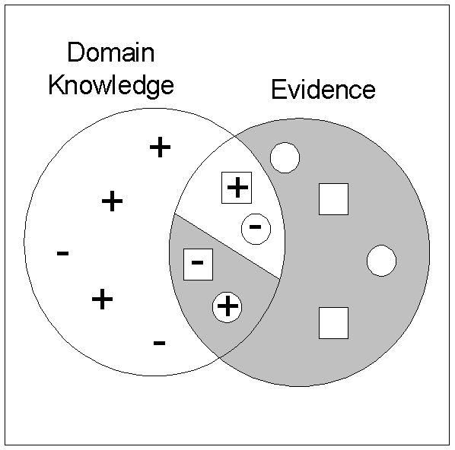
Interestingness via Unexpectedness
Need to model expectation of users (domain knowledge)
Need to combine expectation of users with evidence from data (i.e., extracted patterns)
+
Pattern expected to be frequent
-
Pattern expected to be infrequent
Pattern found to be frequent
Pattern found to be infrequent
+
-
Expected Patterns
-
+
Unexpected Patterns
Notes:
Interpreting the rules using our world knowledge or domain knowledge, not just by measures

Slide 36
Weka Association Rules
Implemented a variation of Apriori algorithm that iteratively reduces the minimum support until it finds the required number of rules with the given minimum confidence.
Allows mining of “class association rules”. If the data has a class label attribute, the right hand side of a rule can be restricted to that label.

Slide 37
Association Rule Measures
In practice, what levels of support, confidence and lift should we aim for?
Support
Depends on dataset and business problem
Common setting: 20-40% of the transactions
Confidence
Strong confidence rules >=.9, but .6 to .8 range might be o.k.
Lift
should be above 1.0, the higher the better
Levels of 2 and above can occasionally be seen, but more likely to see around 1.3 – 1.5

Slide 38
Exercise: calculate lift
Calculate the lift of rules {A}->{D} and {D}->{A}
Transaction-id | Items bought
10 | A, B, D
20 | A, C, D
30 | A, D, E
40 | B, E, F
50 | B, C, D, E, F

